Slide 1

Introduction to C Programming

Slide 2
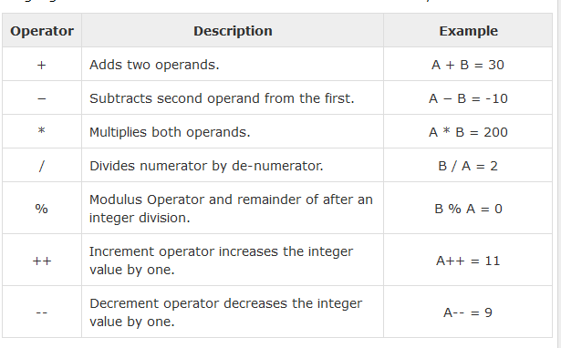
Operators
Assume variable A holds 10 and variable B holds 20

Slide 3
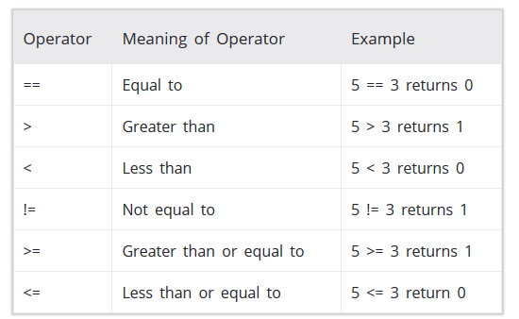
C: Relational Operators
A relational operator checks the relationship between two operands. If the relation is true, it returns 1; if the relation is false, it returns value 0.
Relational operators are used in decision making and loops.

Slide 4
// C Program to demonstrate the working of arithmetic operators
#include <stdio.h>
int main()
{
int a = 5, b = 5, c = 10;
printf("%d == %d = %d \n", a, b, a == b);
printf("%d == %d = %d \n", a, c, a == c);
printf("%d > %d = %d \n", a, b, a > b);
printf("%d > %d = %d \n", a, c, a > c);
printf("%d < %d = %d \n", a, b, a < b);
printf("%d < %d = %d \n", a, c, a < c);
printf("%d != %d = %d \n", a, b, a != b);
printf("%d != %d = %d \n", a, c, a != c);
printf("%d >= %d = %d \n", a, b, a >= b);
printf("%d >= %d = %d \n", a, c, a >= c);
printf("%d <= %d = %d \n", a, b, a <= b);
printf("%d <= %d = %d \n", a, c, a <= c);
return 0;
}
Output ??

Slide 5
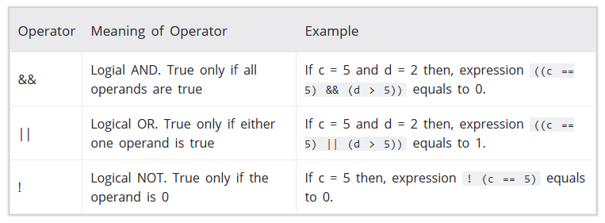
C: Logical Operators
An expression containing logical operator returns either 0 or 1 depending upon whether expression results true or false.

Slide 6
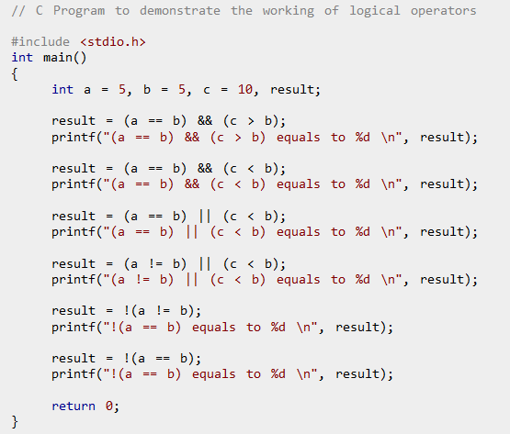

Slide 7
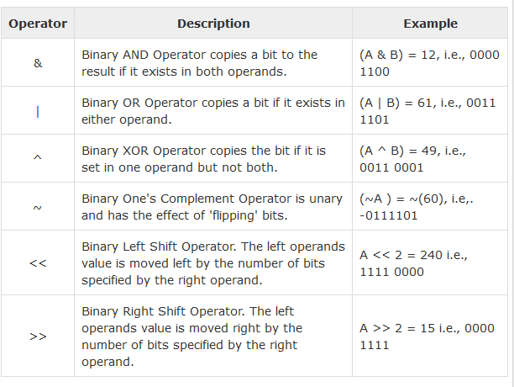
C: Bitwise Operators
Assume variable 'A' holds 60 and variable 'B' holds 13

Slide 8
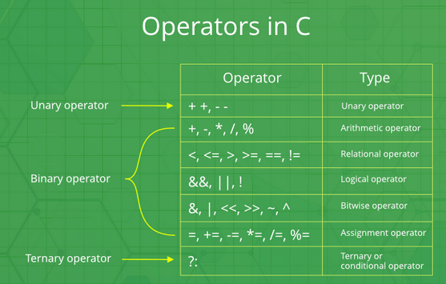
C: Operators

Slide 9
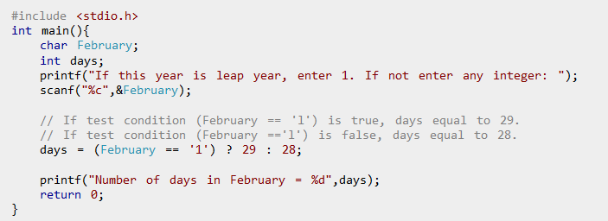
C: Conditional Operator
Ternary operator is a conditional operator that works on 3 operands.
conditionalexpression ? expression1 : expression2

Slide 10
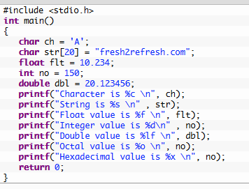
C: Input-Output
In C programming language, printf() function is used to print the “character, string, float, integer, octal and hexadecimal values” onto the output screen.
We use printf() function with %d format specifier to display the value of an integer variable.
Similarly %c is used to display character, %f for float variable, %s for string variable, %lf for double and %x for hexadecimal variable.
To generate a newline,we use “\n” in C printf() statement.

Slide 11
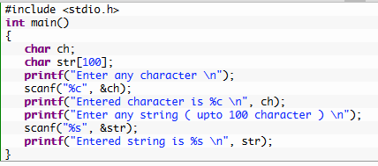
C: Input-Output
In C programming language, scanf() function is used to read character, string, numeric data from keyboard
Consider below example program where user enters a character. This value is assigned to the variable “ch” and then displayed.
Then, user enters a string and this value is assigned to the variable “str” and then displayed.

Slide 12
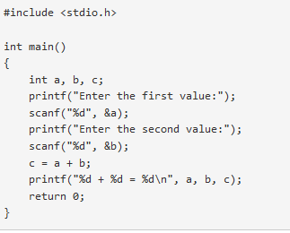
C: Input-Output
KEY POINTS TO REMEMBER IN C PRINTF() AND SCANF():
printf() is used to display the output and scanf() is used to read the inputs.
printf() and scanf() functions are declared in “stdio.h” header file in C library.
All syntax in C language including printf() and scanf() functions are case sensitive

Slide 13
C: Decision Making
if Statement
Example: if Statement
if...else Statement
Example: if...else Statement
if...else Ladder
Example: if...else Ladder
Nested if...else
Example: Nested if...else

Slide 14
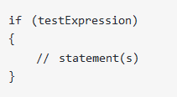
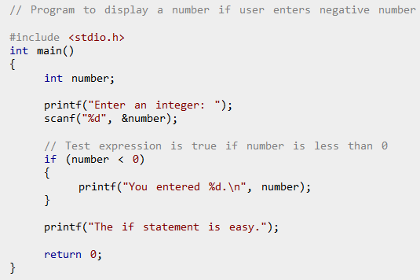
C: Decision Making

Slide 15
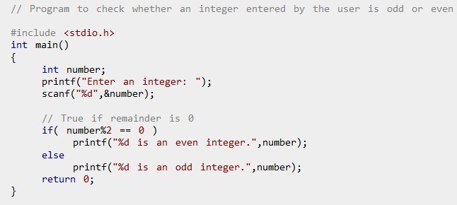
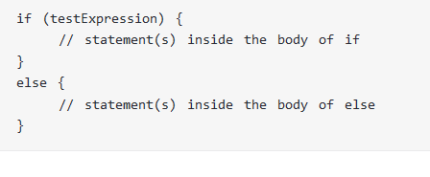
C: Decision Making

Slide 16
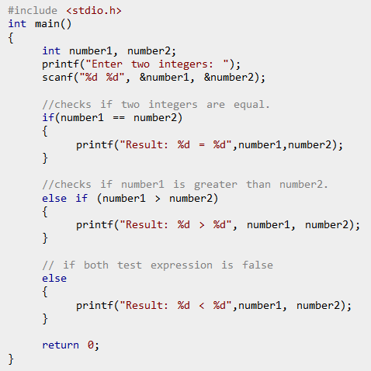
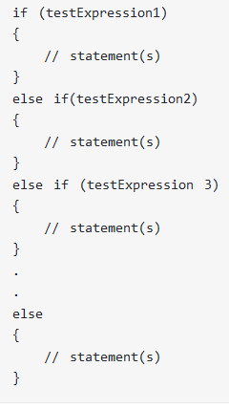
C: Decision Making

Slide 17
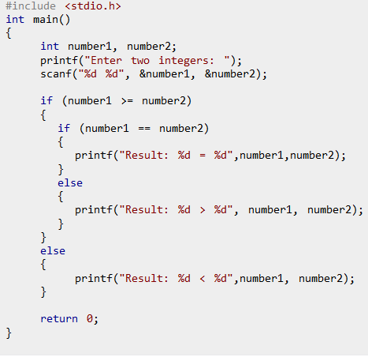
C: Decision Making
Nested if...else
It is possible to include if...else statement(s) inside the body of another if...else statement.

Slide 18
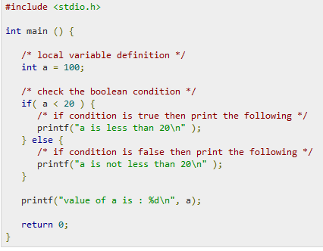
C: Decision Making
Output ??

Slide 19
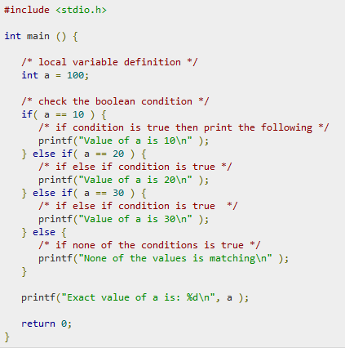
C: Decision Making
Output ??

Slide 20
C: Decision Making
Output ??

Slide 21
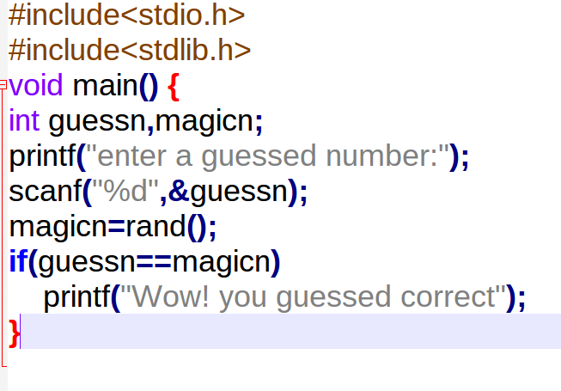
Output ??

Slide 22
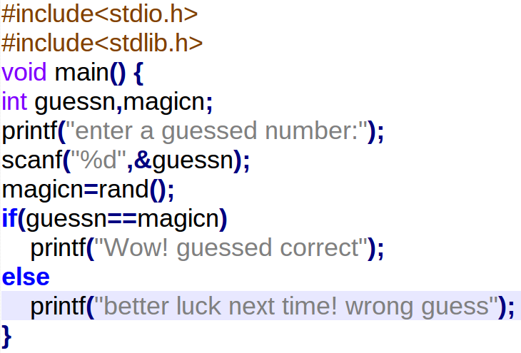
Output ??

Slide 23
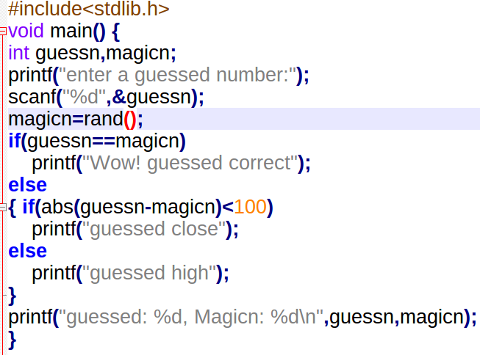
Output ??

Slide 24
C: Problems on Decision Making
Write a program to find maximum between three numbers.
Write a program to check whether a number is negative, positive or zero.
Write a program to check whether a number is divisible by 5 and 11 or not.
Write a program to check whether a number is even or odd.
Write a program to input week number and print week day.
A shop will give discount of 10% if the cost of purchased quantity is more than 1000. Ask user for quantity. Suppose, one unit will cost 100. Calculate and print total cost for user.
Write a program to input angles of a triangle and check whether triangle is valid or not.
Write a program to input Percentage. Calculate percentage and grade according to following: Percentage >= 90% : Grade A Percentage >= 80% : Grade B Percentage >= 70% : Grade C Percentage >= 60% : Grade D Percentage >= 40% : Grade E Percentage < 40% : Grade F
Write a program to input basic salary of an employee and calculate its Gross salary according to following: Basic Salary <= 10000 : HRA = 20%, DA = 80% Basic Salary <= 20000 : HRA = 25%, DA = 90% Basic Salary > 20000 : HRA = 30%, DA = 95%
Write a program that computes the real roots of a quadratic function. Your program should begin by prompting the user for the values of a, b and c. Then it should display a message indicating the nature of real roots, along with the values of the real roots (if any).

Slide 25
C: Loops
Some programs often need to perform the same task multiple times
Disadvantages to duplicating code
Makes program large
Time consuming
May need to be corrected in many places
Something needs to occur multiple times (generally it will repeat itself as long as some condition has been met).
Example 1:
Flowchart
Play again?
N
Play again?
Y
Run game again
Re-running the Game
END GAME

Slide 26
C: Loops
Test Loops
Initialize loop control
Check if the repeating condition has been met
If it’s been met then go to Step 3
If it hasn’t been met then the loop ends
Execute the body of the loop (the part to be repeated)
Update the loop control
Go to step 2
Initialize loop control
Condition met?
No
Yes
Execute body
Update control
After the loop (done looping)
slide 3

Slide 27
C: Loops
For
While
Do While
Characteristics:
The stopping condition is checked before the body executes.
These types of loops execute zero or more times.

Slide 28

C: for Loop
For loop:
The init step is executed first, and only once. This step allows you to declare and initialize any loop control variables.
the condition is evaluated. If it is true, the body of the loop is executed. If it is false, the body of the loop does not execute and the flow of control jumps to the next statement just after the 'for' loop.
After the body of the 'for' loop executes, the flow of control jumps back up to the increment statement. This statement allows you to update any loop control variables.
The condition is now evaluated again. If it is true, the loop executes and the process repeats itself (body of loop, then increment step, and then again condition). After the condition becomes false, the 'for' loop terminates.

Slide 29
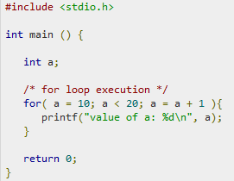
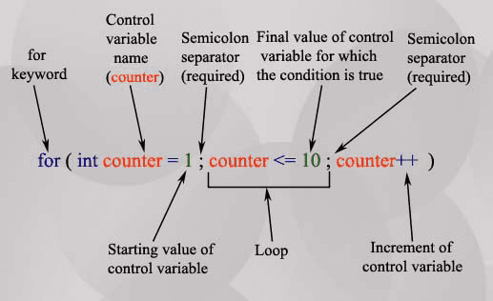
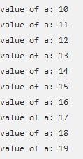
C: for Loop
For loop:

Slide 30
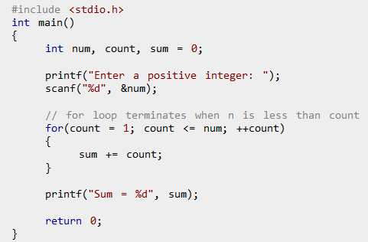
C: for Loop
For loop:

Slide 31
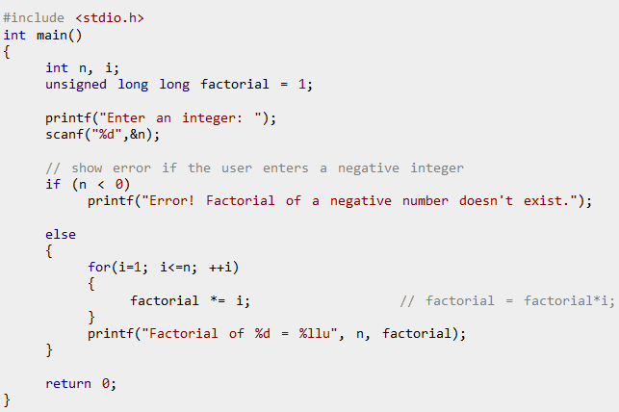
C: for Loop
For loop example:

Slide 32
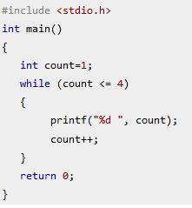
C: While Loop
Initialization;
while (Condition)
{
statements;
Increment;
}

Slide 33
C: While Loop
Program name: while1.c
#include<stdio.h>
void main(){
int i=1;
while(i<=4)
{
print(“%d\n",i);
i=i+1;
}
printf("Done!");
}
1) Initialize control
2) Check condition
3) Execute body
4) Update control
In order for a loop to stop executing, something has to happen inside the loop to make the condition false.
Iteration: one execution of the body of a loop

Slide 34
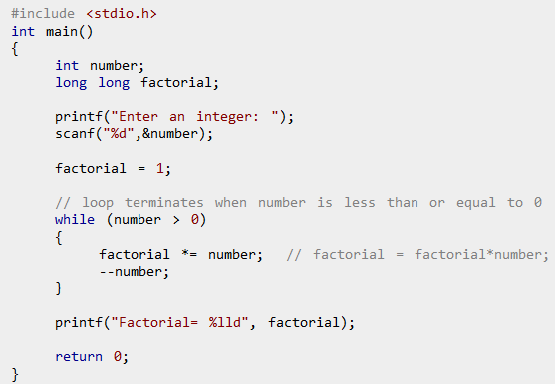
C: While Loop

Slide 35
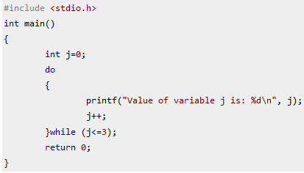

C: Do While Loop
Syntax of do-while loop
Initialization;
do
{
statements;
Increment;
} while (Condition);

Slide 36
C: Practice Problems on loops
Write a program to print the squares of 1,2,...,10 with for loop.
Write a program to print the squares of 1,2,...,10 with while loop.
Find n! for given n as an input from keyboard.
Find the sum of first n integers for given n
Write a program to find those numbers which are divisible by 7 and multiple of 5, between 1 and 100.
Write a program that prints all the numbers from 0 to 6 except 3 and 6.
Write program to print output as following
1
1 1
1 1 1
1 1 1 1
A Fibonacci sequence is the integer sequence of 0, 1, 1, 2, 3, 5, 8....
Print multiplication table of n using loop for given number n.
Write a for loop that writes out the decimal equivalent of the reciprocals 1/2, 1/3,1/4, ... , 1/19, 1/20.
Write a for loop that writes out the decimal equivalent of the series 1/2+1/3+1/4+ ... +1/19+1/20.
Given two input number A and B. Find the sum of number between A and B.
For example: input: A=2, B=5 output:14 (2+3+4+5)

Slide 37
C: Continue Statement
#include <stdio.h>
int main()
{
for (int j=0; j<=8; j++)
{
if (j==4)
{ continue;
}
printf("%d ", j);
}
return 0;
}
Output:
0 1 2 3 5 6 7 8

Slide 38
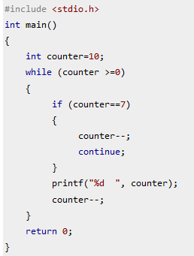
C: Continue Statement
Output:
10 9 8 6 5 4 3 2 1 0

Slide 39
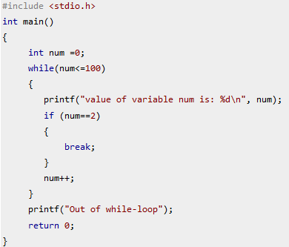
C: Break Statement
Output:
value of variable num is: 0
value of variable num is: 1
value of variable num is: 2
Out of while-loop

Slide 40
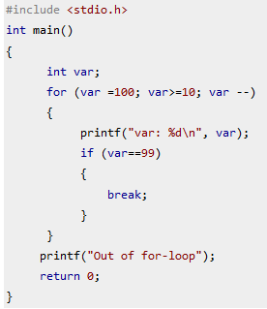
C: Break Statement
Output:
var: 100
var: 99
Out of for-loop

Slide 41
C: Break Statement
Output:
var: 100
var: 99
Out of for-loop

Slide 42
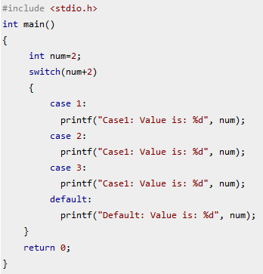
C: Switch Case Statement
switch (variable or an integer expression)
{
case constant:
//C Statements
;
case constant:
//C Statements
;
default:
//C Statements
;
}
Output: Default: value is: 2

Slide 43
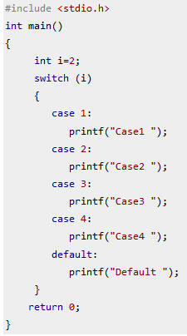
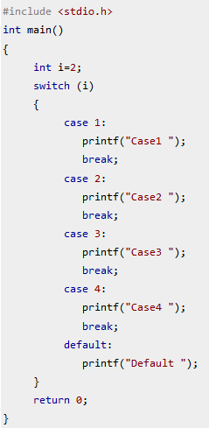
C: Switch Case Statement
Output:
Case2
Output:
Case2 Case3 Case4 Default

Slide 44
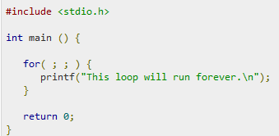
C: Infinite loop
for(;;)
{
// Do your task here
}
while(1)
{
// Do your task here
}

Slide 45
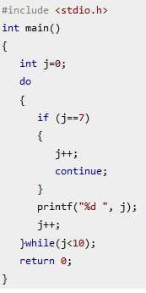
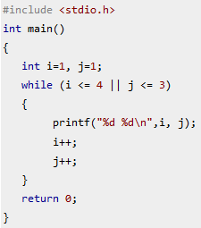
C: loops examples
Output ??
Output ??

Slide 46
C: Practice Problems on loops
Print the following pattern as a output:
*********
*0*0*0*0*
*********
*0*0*0*0*
*********
Write a program that prompts user to enter numbers. The process will repeat until user enters 0. Finally, the program prints sum of the numbers entered by the user.
Print the factors of given number.
Check given number n is prime number or not.
Write a program to find greatest common divisor (GCD) or highest common factor (HCF) of given two numbers.
Take 10 integers from keyboard using loop and print their average value on the screen.
Write a program to print all the numbers from 1 to 1000 that are not divisible by 2, 3, 5, 7, 11, 13, 17 and 19.
Write a program that prints the 5×5 identity matrix.

